Slide 1
FACE RECOGNITION IN DEEP LEARNING
Created by
V. Sujiprabha
Reg.No.912321104047
III year CSE
SACS MAVMM Engineering College, Madurai.

Slide 2
Project Agenda:
Problem statement
Proposed System/Solution
System Deployment Approach
Algorithm and Deployment
Result
Conclusion
References

Slide 3
Problem Statement:
In face recognition using deep learning, the problem statement typically involves training a model to accurately identify and verify individuals from images or video frames.

Slide 4
Proposed System/Solution:
1.Data Collection and preprocessing:
Gather a diverse dataset of face images, ensuring a wide range of variations in lighting, pose, expression and occlusion.
2.Model Architecture Selections:
Choose an appropriate deep learning architecture for face recognitions, such as convolutional neural networks

Slide 5
Proposed System/Solution (contd...)
3.Face Detection:
Implement a face detection algorithm to locate faces within images or video fames.
4.Features Extraction:
Extract facial features from the detected faces using the trained deep learning model.
5.Matching and Recognition:
Compare the extracted facial features of the face recognition system using metrics such as accuracy, precision, recall, and F1-score.

Slide 6
Proposed System/Solution (contd...)
6.Deployment:
Deploy the trained model as a face recognition system in real-word application.
7.Continuous improvement:
Continuously monitor and update the face recognition system to adapt to changes in the environment, improve accuracy and address any potential biases or limitation.

Slide 7
System Deployment Approach:
1.Model Optimization:
Techniques such as model quantization, pruning and compression can be used to reduce the model size and computational complexity without significantly sacrificing accuracy.
2.Hardware Selection:
This may involves deploying the CPUs, GPUs or specialized hardware accelerators like TPUs or FPGAs depending on the specific application requirements.

Slide 8
System Deployment Approach (contd...)
3.Software Integration:
Integrate the optimized deep learning model into the target software environment, whether it’s a standalone application, a web service or an embedded system.
4.Interface Design:
Design user interfaces or application programming interfaces for interacting with the face recognition system.

Slide 9
System Deployment Approach (contd...)
5.Testing and Validation:
Conduct thorough testing and validation of the deployment system to ensure its functionality, performance and reliability.
6.Deployment Strategy:
Define a deployment strategy based on the specific requirements and constraints of the applications.

Slide 10

Algorithm And Deployment: Algorithm:
1.Face Detection:
Utilize a face detection algorithm to locate faces within an image or video frame.
Common methods includes cascades, SDD, Faster R-CNN or MTCNN.
2.Face Alignment:
Align detected faces to a canonical pose for consistency and featured extraction.
Techniques like landmark detection or transformation to be used

Slide 11
Algorithm (contd…)
3.Embedding Generation:
This embedding should be invariant to irrelevant variation like lighting and pose, while still being discriminative for different individuals.
4.Distance Calculation:
Compare the embedding of different faces using distance metrics such as cosine similarity or Euclidean distances.

Slide 12
Deployment:
Cloud-based Deployment:
Deploy the face recognition system on cloud infrastructure (e.g., AWS, Azure, Google Cloud)
Edge Computing:
This approach offers low latency and privacy benefits by processing data locally without relying on cloud services. Models are optimized for inference on resource-constrained devices.

Slide 13
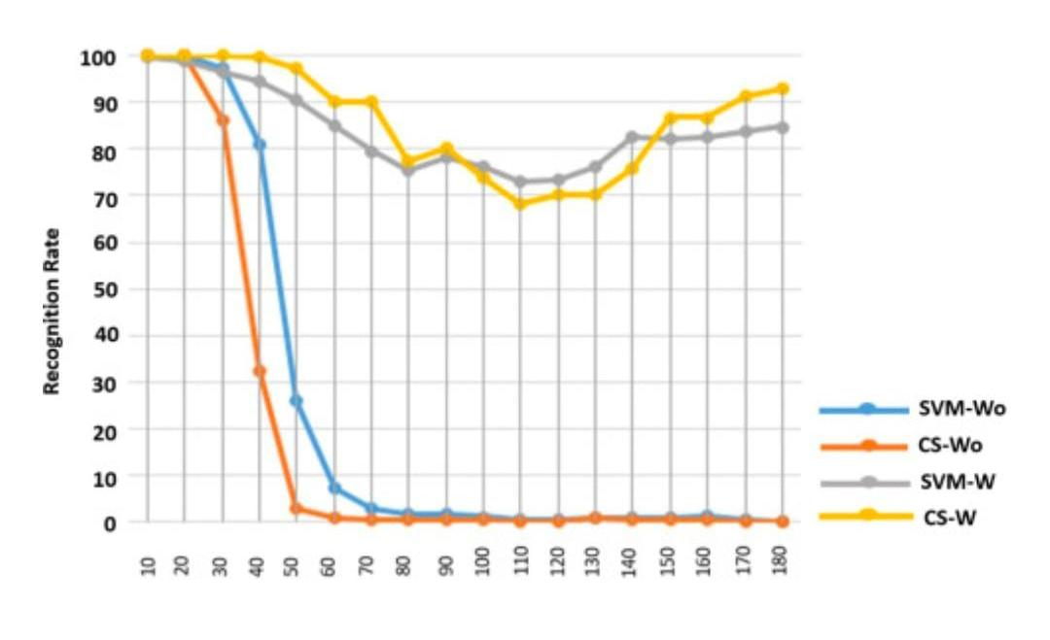
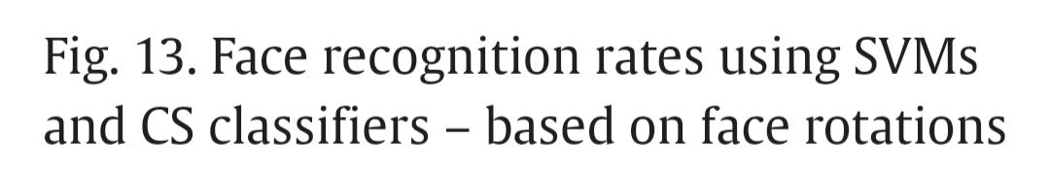
Result:

Slide 14
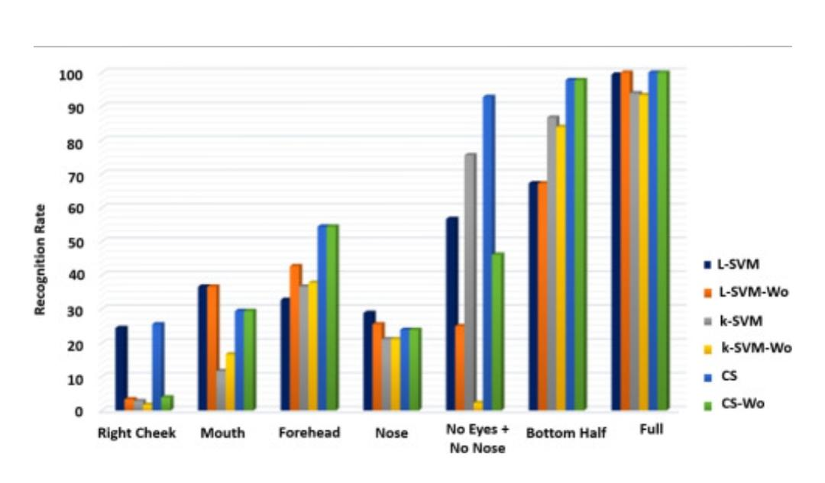
Result (contd…)
Fig.24.The results of the recognition task when some parts of the face (cheeks and the part with no eyes and no nose) are removed from the training sets.

Slide 15
Conclusion:
Whether deployed in the cloud, on-premises, or at the edge , face recognition system must be rigorously tested, monitored and maintained to ensure optimal performance and reliability in real-world applications.

Slide 16
References:
https://arxiv.org/abs/1506.04878
https://arxiv.org/abs/1503.03832
https://arxiv.org/abs/1412.5661
Dataset:
https://github.com/aakashjhawar/face-recognition-using-deep-learning/blob/master/extract_embeddings.py

Slide 17
Thank you

